Slide 1
Chapter 8 Objects and Classes
Part 2

Slide 2
Adding GUI Components to Window
You can add graphical user interface components, such as buttons, labels, text fields, combo boxes, lists, and menus, to the window. The components are defined using classes. Here is an example to create buttons, labels, text fields, check boxes, radio buttons, and combo boxes.
GUIComponents
Run

Slide 3
Static Variables, Constants, and Methods
Static variables are shared by all the instances of the class.
Static methods are not tied to a specific object.
Static constants are final variables shared by all the instances of the class.

Slide 4
Static Variables, Constants, and Methods, cont.
To declare static variables, constants, and methods, use the static modifier.

Slide 5
Visibility Modifiers and
Accessor/Mutator Methods
By default, the class, variable, or method can be
accessed by any class in the same package.
public
The class, data, or method is visible to any class in any package.
private
The data or methods can be accessed only by the declaring class.
The get and set methods are used to read and modify private properties.

Slide 6
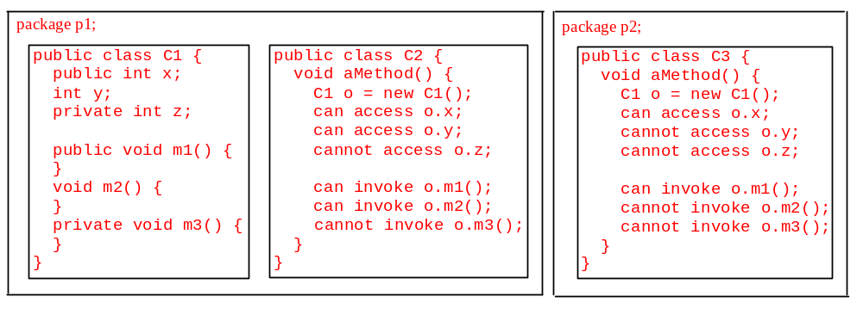
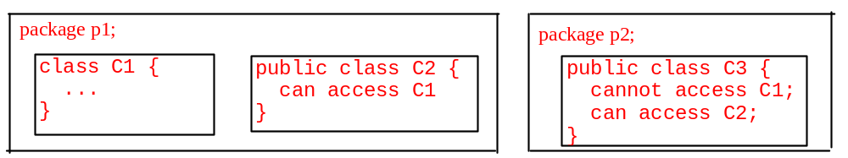
The private modifier restricts access to within a class, the default modifier restricts access to within a package, and the public modifier enables unrestricted access.

Slide 7
Why Data Fields Should Be private?
To protect data.
To make class easy to maintain.

Slide 8
Array of Objects
Circle[] circleArray = new Circle[10];
An array of objects is actually an array of reference variables. So invoking circleArray[1].getArea() involves two levels of referencing as shown in the next figure. circleArray references to the entire array. circleArray[1] references to a Circle object.

Slide 9
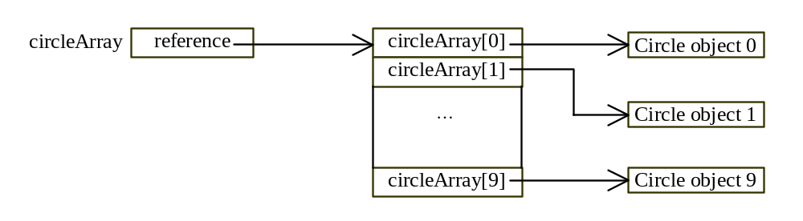
Array of Objects, cont.
Circle[] circleArray = new Circle[10];

